Slide 1
1 Thessalonians 1:1-10
(English Standard Version)
2 Slides

Slide 2
1 Paul, Silvanus, and Timothy,
To the church of the Thessalonians in God the Father and the Lord Jesus Christ:
Grace to you and peace.
² We give thanks to God always for all of you, constantly mentioning you in our prayers, ³ remembering before our God and Father your work of faith and labour of love and steadfastness of hope in our Lord Jesus Christ. ⁴ For we know, brothers loved by God, that he has chosen you, ⁵ because our gospel came to you not only in word, but also in power and in the Holy Spirit and with full conviction. You know what kind of men we proved to be among you for your sake.

Slide 3
⁶ And you became imitators of us and of the Lord, for you received the word in much affliction, with the joy of the Holy Spirit, ⁷ so that you became an example to all the believers in Macedonia and in Achaia. ⁸ For not only has the word of the Lord sounded forth from you in Macedonia and Achaia, but your faith in God has gone forth everywhere, so that we need not say anything. ⁹ For they themselves report concerning us the kind of reception we had among you, and how you turned to God from idols to serve the living and true God, ¹⁰ and to wait for his Son from heaven, whom he raised from the dead, Jesus who delivers us from the wrath to come.

Slide 4
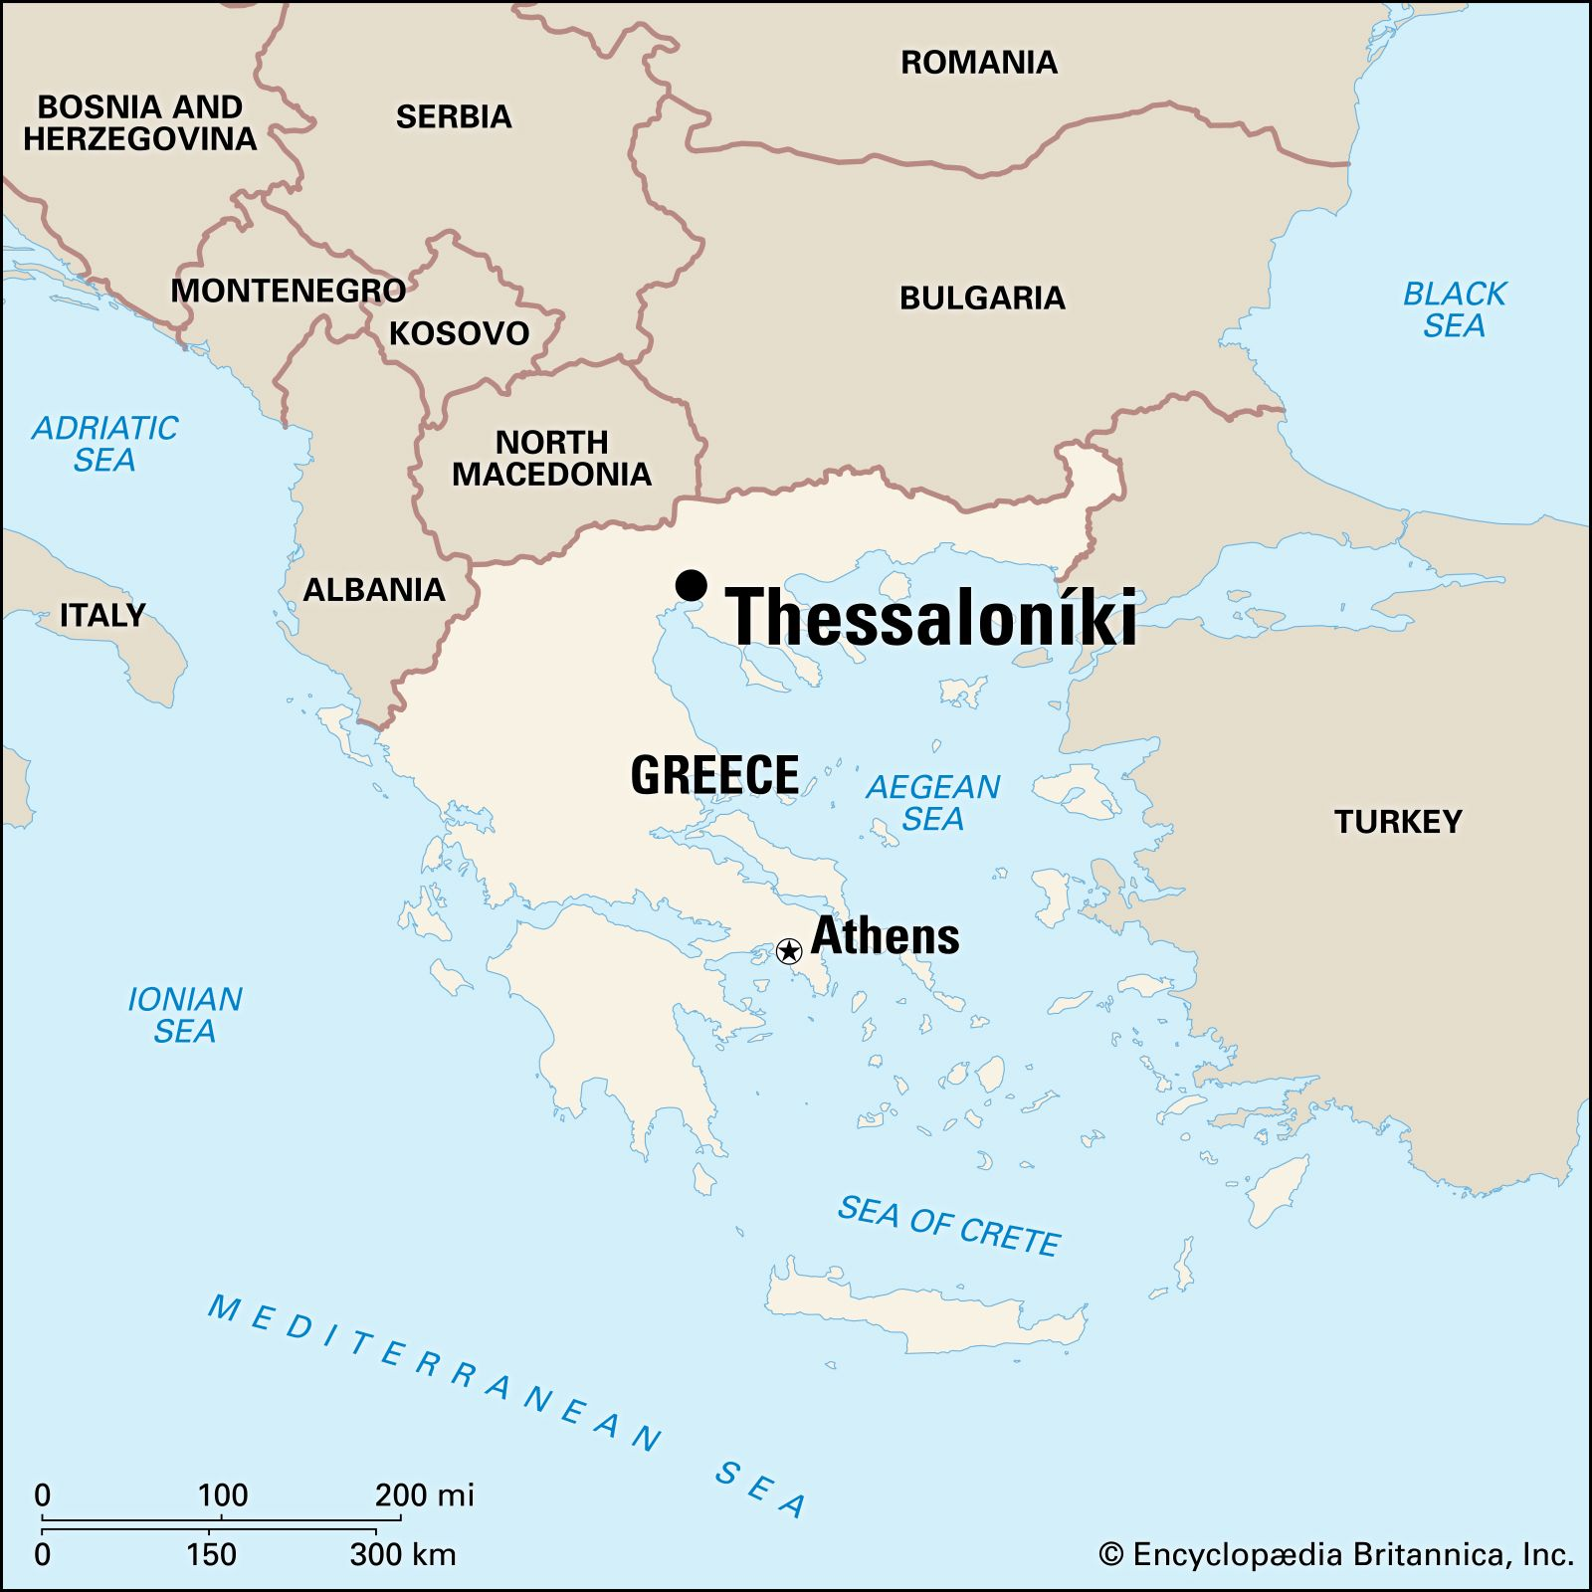
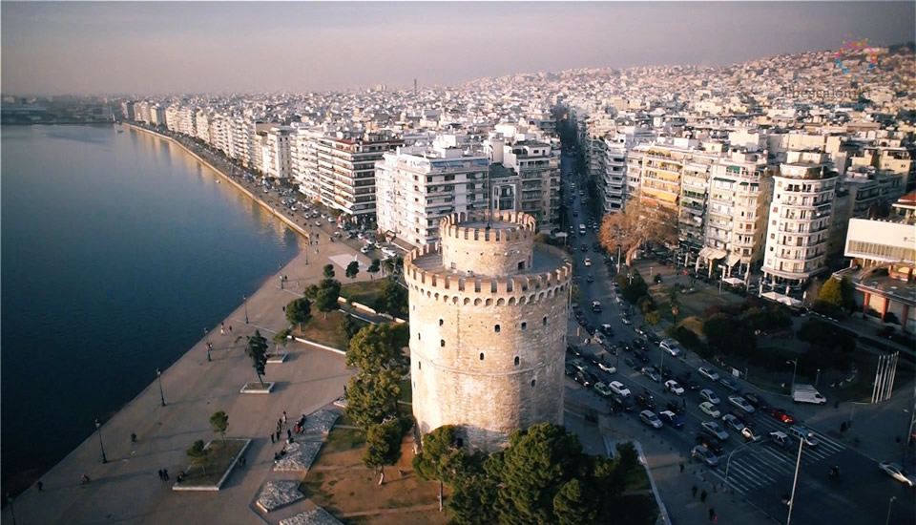
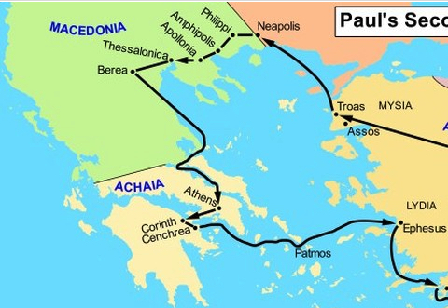
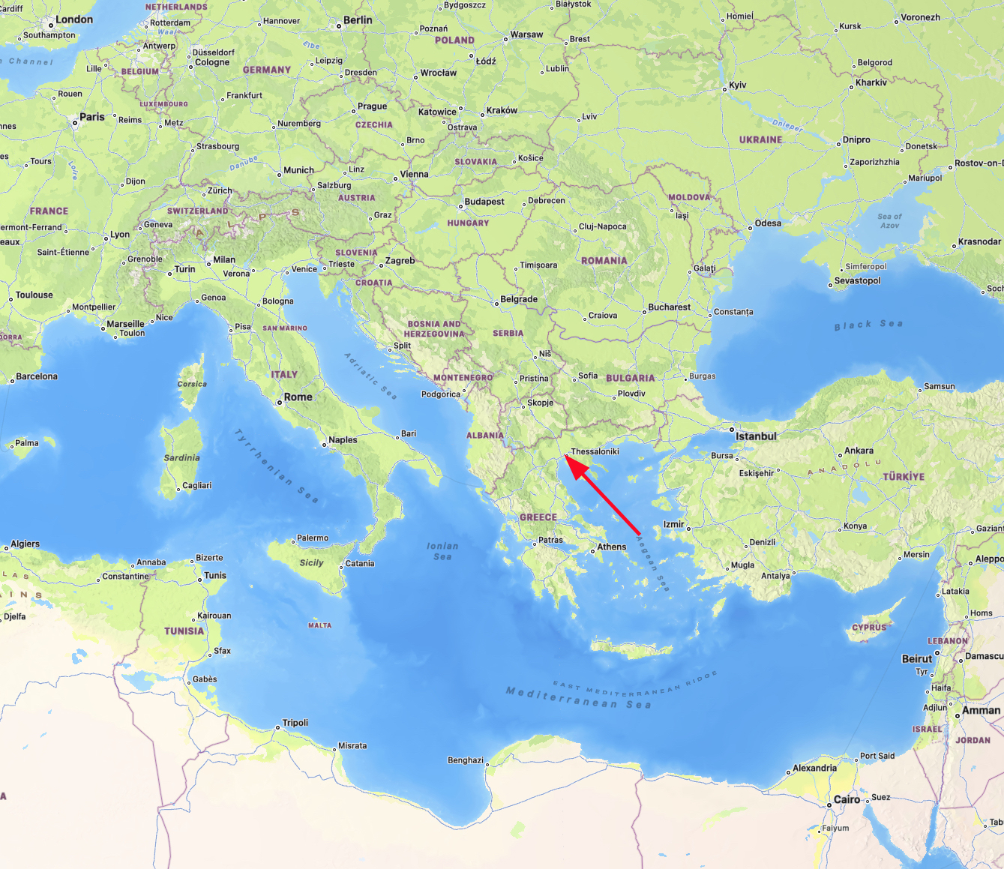

Slide 5
Church of Thessalonians - Evidence of: A Deep Faith Commitment to Jesus
The Gospel of Jesus Christ turns an upside-down world the right way up.
The Mission to Thessalonica was effective. Brothers and Sisters in Christ.
To the church of the Thessalonians in God the Father and the Lord Jesus Christ:
Where we are:
No matter the circumstance or location, we are “in Christ”
Who we are:
The Church; The Gathered ones of Jesus
Work of Faith
Good works as result of faith
Faith to receive Jesus;
Labour of Love
To serve (labour) because of the Love we have
To Love others
Steadfastness of hope in the Lord Jesus Christ
Never abandoning faith. Hold fast to Jesus

Slide 6
A Deep Faith Commitment to Jesus
Work of Faith
Good works as result of faith
Faith to receive Jesus;
Labour of Love
To serve (labour) because of the Love we have
To Love others
Steadfastness of hope in the Lord Jesus Christ
Never abandoning faith. Hold fast to Jesus
How they became “Brothers” (how Paul knew they were genuine in faith)
What God did:
Loved them. Gave His only Son. Died for our Salvation
He Chose them. The chosen: Believe in Jesus Christ; Repent; Continue in Faith.
What Paul & Silas did:
They turned up (obedient response to call of God)
Proclaimed the Gospel. Holy Spirit gives words of witness power
Full Conviction. Sure of the message they proclaimed. Lived what they believed.
What the Thessalonians did:
Imitators of Paul & Silas (Took on the same faith)
Imitators of Jesus. Changed to become Christ-like.
Fruit of the Spirit (e.g. joy in suffering); Witness for Jesus; Life transformed.
Overall, their salvation was a miracle of God. His hand at work in every step.
A Deepening of our Faith Commitment to Jesus

